Slide 1
Decoding the Depths: A Holistic Exploration of Mental Health in India (1990-2022)
By: Aryan Sood(E23MCAG0047)
Shruti Pathak(E23MCAG0033)

Slide 2
Introduction
This report focuses on the versatile landscape of mental health, decrypting the sophisticated tapestry of factors that are responsible for the quality of life of an individual across the nation. WHO estimated that globally over 450 million people suffer from mental disorders. Currently, mental and behavioural disorders account for about 12 percent of the global burden of diseases.[2] By thoroughly studying data from 1990 to 2022, this report aims to interpret various trends, patterns, and the impact of economic, cultural, and healthcare variables on different mental health disorders.
Through a very coordinated approach, this study navigates the extensiveness of various mental health disorders, which range from depression to various types of anxiety disorders like schizophrenia and eating disorders. Without mental and psychological well-being individuals cannot attain a healthy status.[3] The report puts emphasis on various statistical analyses, visualizations, and various assessments to find various insights that contribute to a complete cognition of mental health dynamics. By putting more emphasis on various divergences, emerging trends, and potential contributing factors, this campaign seeks to aware public discourse, guide various policy formations, and build a more sympathetic and decisive approach toward mental health in our country.

Slide 3
Abstract
Mental Health has always been a crucial aspect of the overall well-being of an individual. Still, it is neglected and left untouched in various parts of India. Our report focuses on the intricacies of mental health in India, covering the years from 1990 to 2022. It comprises a thorough analysis of the extensiveness, symptoms, and different treatment options related to mental health in our country. This report sheds light on the significant rise in mental health concerns over a substantial period, prioritizing the need for rapid and effective rectifications.
The report diligently analyses the socio-cultural and economic parameters of mental health in India, emphasizing the impact of sex discrimination, poverty, and social stigma on individual mental well-being. It draws attention to the crucial role of mental health education and various awareness campaigns in nullifying various misperceptions and cultivating a healthy environment for those who are struggling with any type of mental disorder.[1]
Moreover, the report also covers various healthcare infrastructure and resources that are dedicated to mental health in India. It is important to understand the broad gap between the challenges and desirable outcomes that are hindering access to quality care. It guides everyone towards improving mental health services, specifically in rural and under-resourced areas, to make sure that everyone in this country has the opportunity to lead a mentally healthy life.

Slide 4
Software Used
Jupyter Notebook
Anaconda Navigator
Microsoft Excel
Python Libraries

Slide 5
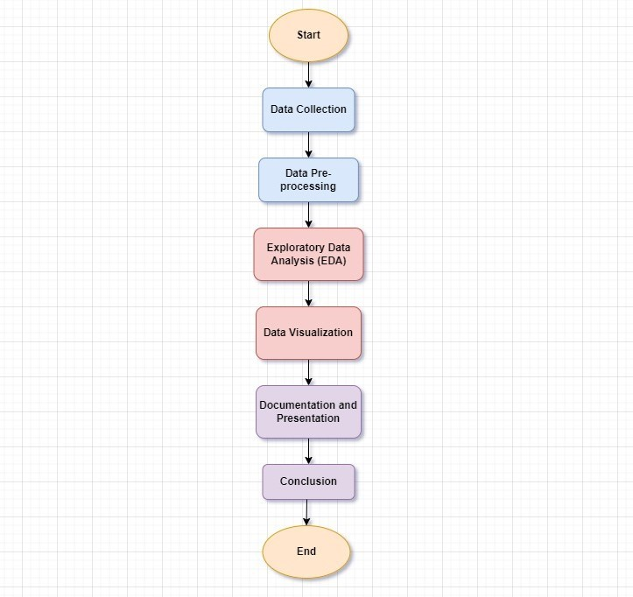
Research Methodology

Slide 6
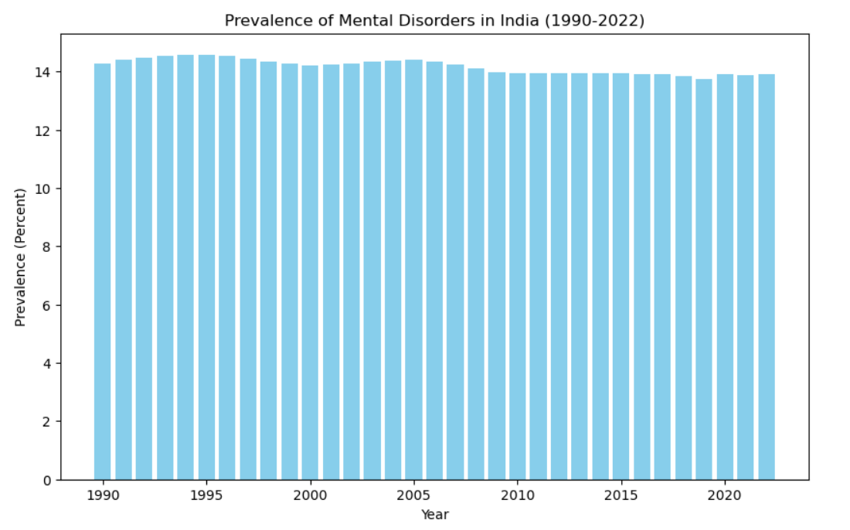
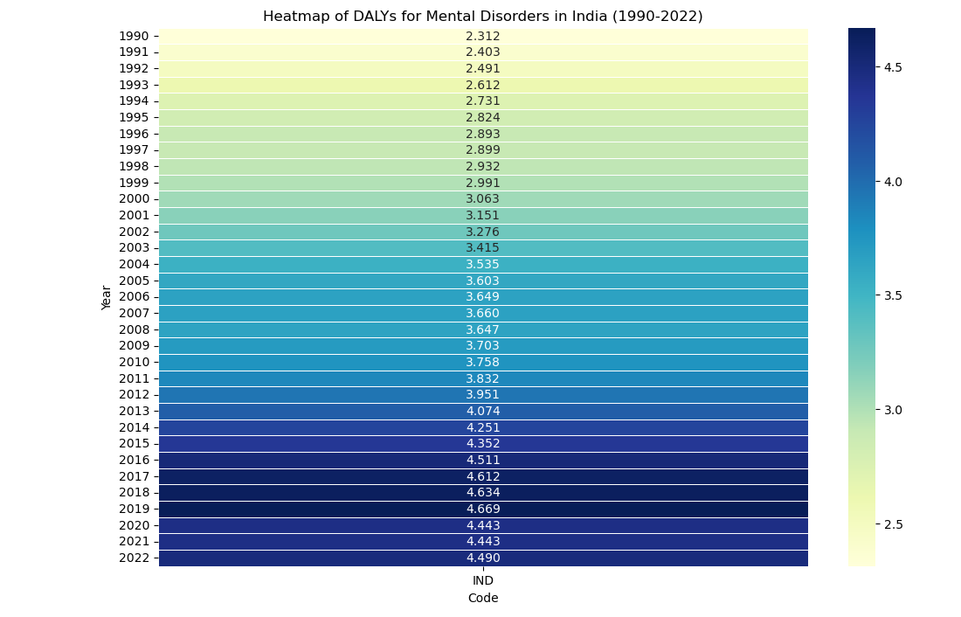
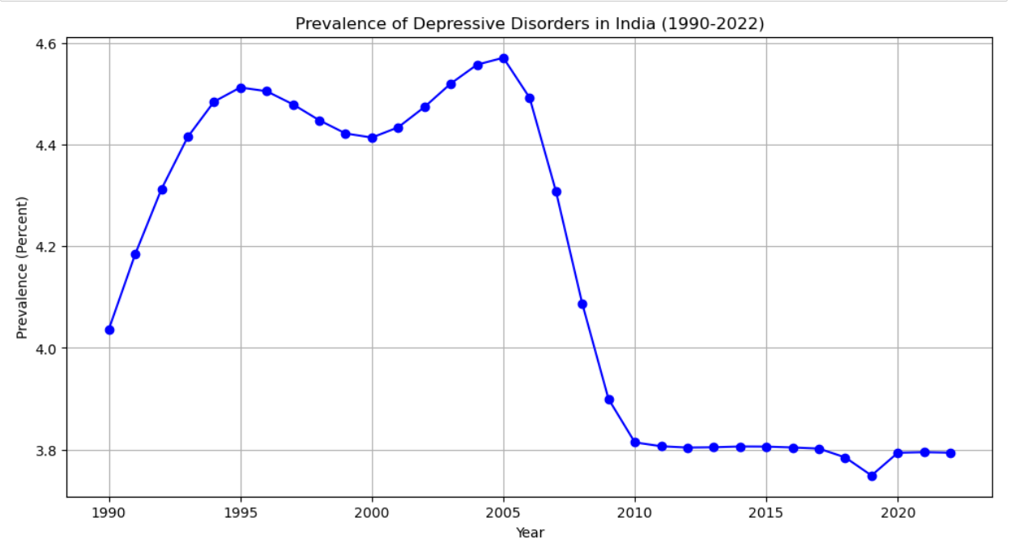
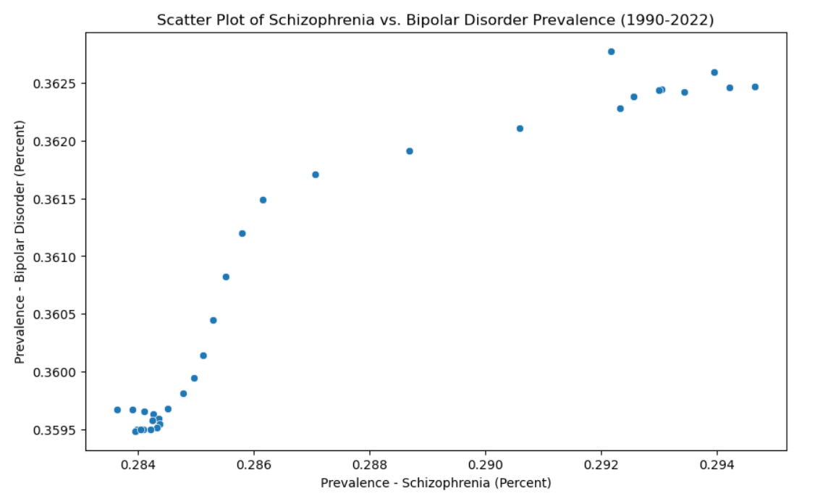
Experimental Analysis

Slide 7
Conclusion
In conclusion, our data underscores the urgent need to address mental health issues in our country. While social media discussions signal progress, the substantial journey ahead involves destigmatizing mental health and ensuring universal accessibility for support. The report advocates a paradigm shift toward proactive mental health care, emphasizing its transformative potential. Immediate attention is crucial, necessitating awareness campaigns and integrating mental health education in schools. The report stresses the demand for accessible diagnostic tests and affordable treatments. A collective effort involving healthcare professionals, government, and communities is essential for fostering a supportive environment and improving mental well-being nationwide.

Slide 8
References
[1] “Effects of Mental Health on Student Learning.”
[2] V. B. Shiva Reddy, A. Gupta, A. Lohiya, and P. Kharya, “Mental Health Issues and Challenges in India: A Review,” International Journal of Scientific and Research Publications, vol. 3, no. 2, 2013, [Online]. Available: www.ijsrp.org
[3] T. Dutta and R. B. Bhagat, “Paper presented at the National Seminar on ‘Suicide and Self-harm: Issues and Challenges’, held at Centre for the Culture and Development The Magnitude of Mental Health Problems in India: Insights from census and large-scale surveys.”

Slide 9
Thank you!

